Slide 1
Graph Topologies and Incentive Stability in Multi-Agent Code Generation
Jason Liu, Charlotte Ma, Nana Ye Master of Data Science and Artificial Intelligence

Slide 2
Motivation
Do complex graph structures inherently discourage high-effort verification from individual agents due to varying systemic incentives?
Multi-agent systems introduce rapidly compounding token and latency costs
Lyu et al. (2025) show that agent failures trace directly to inter-agent miscommunication, implicating topology affect both accuracy and robustness
We must isolate the true hidden variable: Interaction Topology
Notes:
the core question that motivates this work is: do complex graph structures in multiagent systems discourage high-effort verification from individual agents due to misaligned incentives? in multiagent architecture we often assume that adding more agents will improve performance. however, in practice this introduces rapidly compounding costs both in terms of token usage and latency. at the same time, recent work shows that many agent failures can be traced back to inter-agent miscommunication, rather than individual model capability which suggest the way agents are connected may be as important as the agents themselves. so instead of treating multi-agent systems as black boxes, this project asks: what if the hidden variable driving performance is the interaction topology?

Slide 3
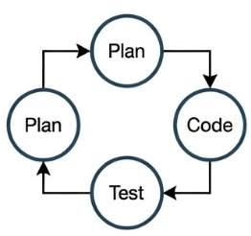


Background
Baseline
Orchestrated Pipelines
Closed-Loop state-of-the-art
Single LLM zero-shot prompts (early GPT-3). Low functional correctness
Frameworks like MetaGPT and AutoGen formalize roles to prevent cascading errors
Reflexion, AgentCoder, MapCoder. Iterative testing maximizes pass rates
Gap: Current state-of-the-art evaluates systems as holistic black box. → We lack isolated, controlled analysis of how the Interaction Topology itself drives performance and token economics
Notes:
to understand this, let look at how multi-agent systems have evolved. from the very left, we have the baseline where A single LLM takes in a prompt and produces an output. This is simple and efficient, but often fails on more complex tasks due to lack of verification.
next we move to orchestrated pipelines where we introduce structured roles such as a planner generates a strategy, a coder implements it, a reviewer then check it. Frameworks like MetaGPT and AutoGen follow this paradigm. however, these frameworks are often evaluated as holistic packages. when they succeed, it is hard to tell if the gain comes from the prompts, the specific tools, or the underlying interaction graph.
finally, we have the closed-loop state of the art, including frameworks like agentcoder, reflexion, mapcoder. these models proved that iterative testing and reflection are game-changers for benchmarks like mbpp. they utilize loops where code is executed in a sandbox and the resulting error logs are fed back to the agent for repair. nonetheless, they vary in prompts, tools, and structure which make it impossible to isolate the effect of topology alone
so the central research objective of this project is: to perform a controlled, systematic study of interaction topology in multiagent coding systems

Slide 4
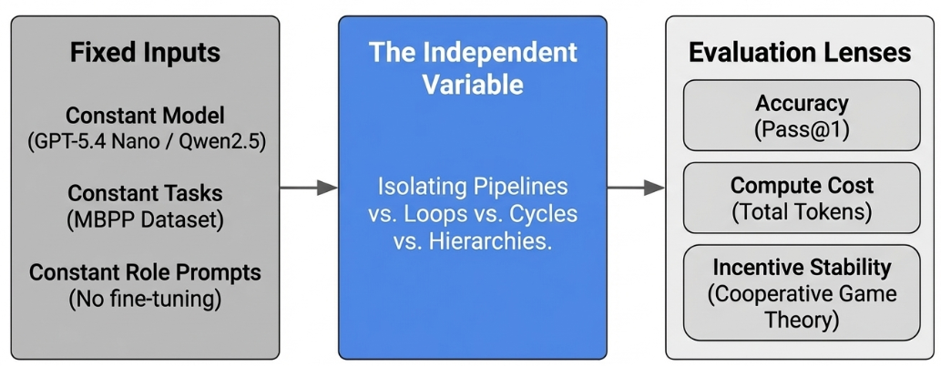
Overview: Our Approach
Notes:
The key idea of our approach is to treat this as a controlled experiment.
First, we fix the input constant across all experiments, this include the model (same LLM backbone), the task distribution (MBPP dataset), and the agent role prompts with no fine-tuning or adaptation. Next, we define the independent variable: graph interaction topology. we systematically vary how agents are connected including linear pipelines, iterative feedback loops, cyclic structures, hierarchical systems. Finally, we evaluate each topology along three dimensions including accuracy, compute cost, and incentive stability

Slide 5
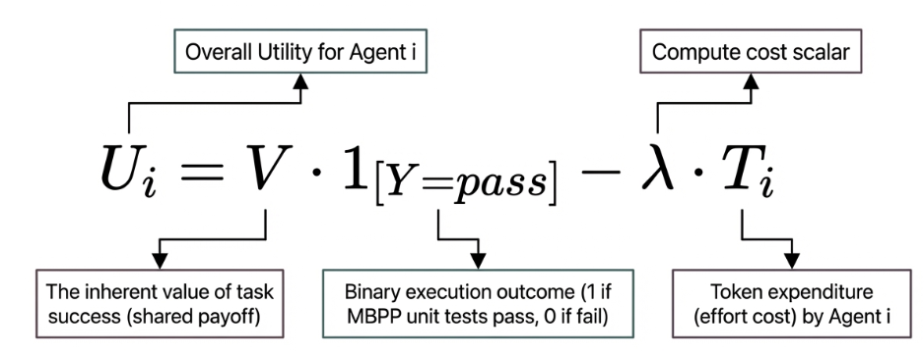
Game Theory Formulation
Photo credit: @bruce.digital
Notes:
to formalize this, we model multi-agent code generation as a cooperative game where each agent contributes to solving a shared task. we define the utility for each agent i as
first term represent the shared reward where v represents the value of successfully completing the task and the indicator function is 1 if the solution passess all unit tests, 0 otherwise. so this means all agents benefit if the system succeeds
second term represent individual cost where ti represents the token usage of agent i and lambda is a scaling factor that controls how costly computation is
so overall, each agent faces a tradeoff, contribute more effort to increase the chance of success vs. minimize their own computational cost. this is where we analyze incentive stability, we approximate whether the system is stable under deviation

Slide 6
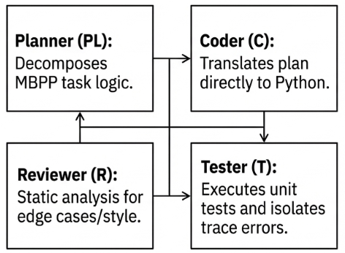
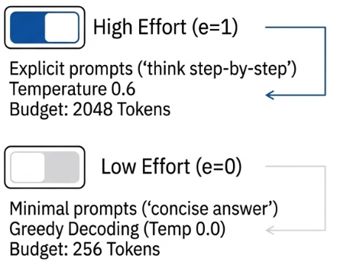
Operational Framework: Agent Roles and Effort Constraints
The Agent Nodes
Effort (e ∈ {0, 1})
Notes:
Here we define our agent nodes and what they can play in the game. We have standard roles: Planner, Coder, Reviewer, and Tester. But since we cannot 'fine-tune' effort out of an API, we manipulate Effort (
e
e) using generation constraints. High effort (
e
=
1
e=1) gives the agent 2048 tokens and reasoning prompts. Low effort (
e
=
0
e=0) starves the agent—capping it at 256 tokens and greedy, 0-temperature decoding. This perfectly simulates an agent throwing lazy, unverified code over the wall."

Slide 7
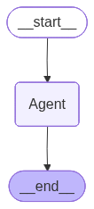
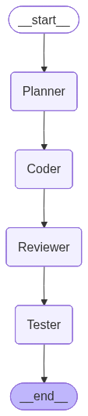
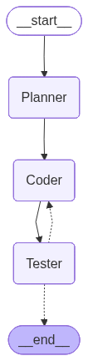
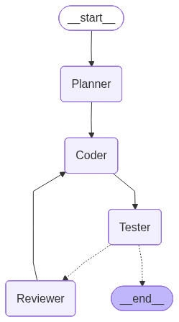
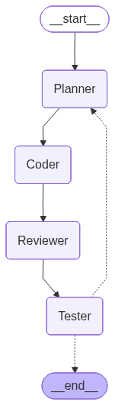
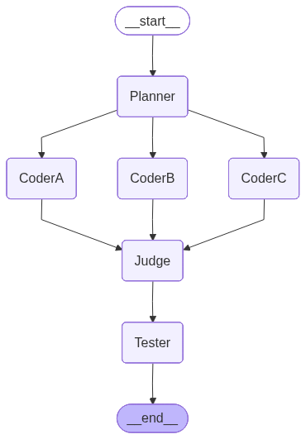
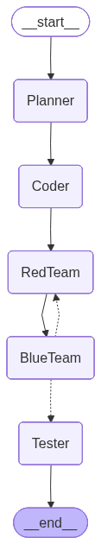
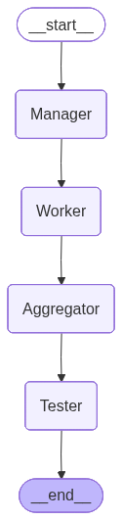
Graph Topologies Overview
G0
G1
G2
G2.5
G3
G4
G5
G6
Photo credit: @bruce.digital
Notes:
### Slide 7: Graph Topologies Overview
**Speaker Notes:**
"These are the exact topologies we evaluated, built in LangGraph. I'll briefly break down how information flows through each one:
- **G0: Baseline (0-shot):** A single Universal Agent mapping input directly to output with no reflection. *(Inspiration: standard ChatGPT zero-shot inference).*
- **G1: Waterfall:** A strictly linear sequence of Planner, Coder, Reviewer, and Tester. There is no backtracking allowed. *(Inspiration: Traditional waterfall SDLC).*
- **G2: AgentCoder:** A tight, conditional loop between Coder and Tester. It iterates dynamically based purely on test execution success. *(Inspiration: AgentCoder, Huang et al., 2023).*
- **G2.5: Reviewer Repair:** Routes test failures through a Reviewer for static analysis *before* returning to the Coder for patching. *(Inspiration: Bridging Reflexion, Shinn et al., 2023, with AgentCoder).*
- **G3: MapCoder:** A massive cyclic flow where test failures trigger a complete re-plan originating all the way back at the Planner, rigorously rebuilding logical rot. *(Inspiration: MapCoder, Islam et al., 2024).*
- **G4: Parallel Judge:** A 'Best-of-N' structure where three parallel Coders produce candidate solutions, and a Judge votes on the best one to forward to the Tester. *(Inspiration: AlphaCode scaling laws and Best-of-N sampling).*
- **G5: Adversarial Debate:** The Coder's script is attacked by a 'Red Team' searching for vulnerabilities, and a 'Blue Team' must defend or patch it before testing. *(Inspiration: Multi-agent debate frameworks / Du et al., 2023).*
- **G6: Hierarchical Setup:** A Manager agent breaks down tasks and hands them off to parallel Workers, followed by an Aggregator. *(Inspiration: MetaGPT and ChatDev organizational trees).*"

Slide 8
Implementation
Dataset
Orchestration
Model
50 targeted coding tasks sourced from the MBPP (Mostly Basic Python Problems) Benchmark.
Graph Topologies implemented using LangGraph. These topologies define how information flows between specialized agent nodes
Token use (penalty) calculated using telemetry callback handlers trace prompt
GPT-5.4 nano API
Qwen2.5-coder-7b local
Photo credit: @bruce.digital

Slide 9
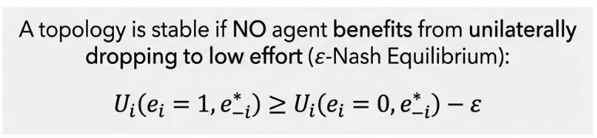
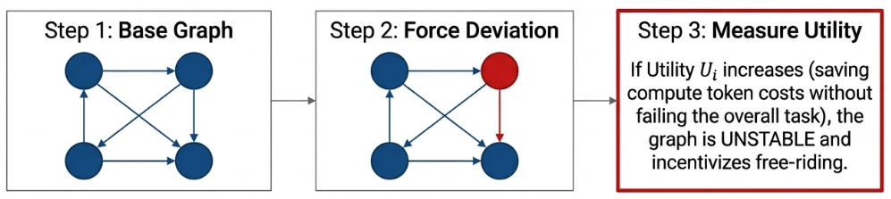
Evaluation: Nash Equilibrium Test
Does the architectural graph topology encourage agents to slack off?
Photo credit: @bruce.digital
Notes:
whether a topology is incentive-stable using an approximate Nash equilibrium criterion.
The idea is to check whether any single agent would benefit from dropping from high effort to low effort while all other agents stay the same.
So first, we run the base graph under the full high-effort setting. Then we make one agent to deviate to low effort and compare its utility vs playing high effort. If that agent’s utility goes up, mainly by saving token cost without hurting the final outcome too much, then the graph is unstable and encourages free-riding.
So this metric tells us whether a topology supports sustained high-effort cooperation, rather than only looking good on pass rate.

Slide 10
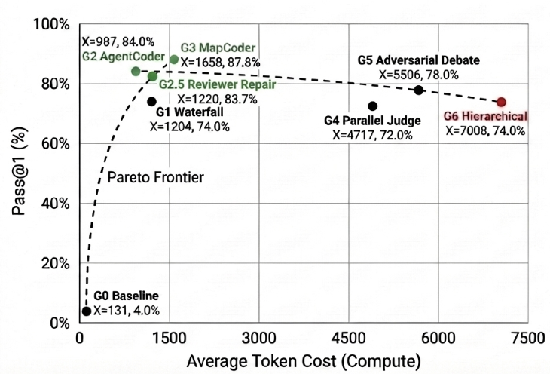
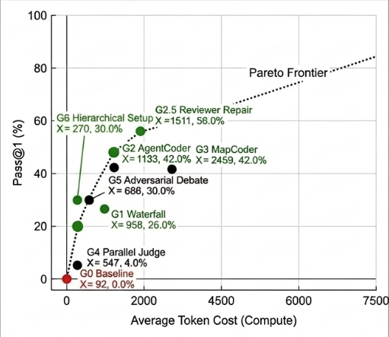
Results GPT-5.4 nano Qwen2.5 coder 7b
Cyclic topologies (G2, G3) vastly outperform other complex parallel graphs (G4, G6) in both accuracy and token cost
Notes:
Let’s examine the results of our study. The left plot shows results for GPT-5.4 nano, and the right plot for Qwen2.5. In both cases, the x-axis represents average token cost, while the y-axis shows pass@1 accuracy.
Although the absolute performance varies across models due to differences in underlying capability, a consistent structural pattern emerges.
Cyclic topologies—particularly G2 (AgentCoder), G2.5 (Reviewer Repair), and G3 (MapCoder)—offer the best trade-off between correctness and compute. These designs leverage tight feedback loops between execution and generation, allowing errors to be iteratively corrected. As a result, they achieve substantially higher accuracy than baselines, while maintaining relatively efficient token usage.
In contrast, more elaborate parallel and hierarchical structures, such as G4 and G6, are significantly less effective. On GPT-5.4 nano, they incur much higher token costs due to communication overhead, yet hardly provide any gain in accuracy
On Qwen2.5, their performance is even weaker—accuracy remains low despite increased compute—suggesting that additional coordination does not compensate for limited base model capability and even damage the performance.

Slide 11
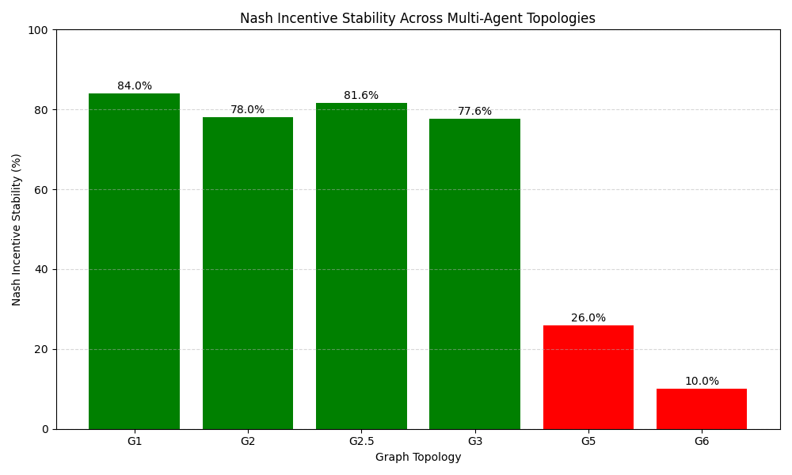
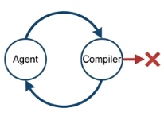
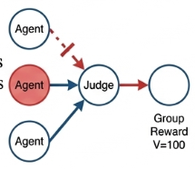
Results
Stable Loops
Unstable Graphs
In G2/2.5/3 loops, if an agent drops effort, the compiler catches the uncompilable code → execution fails, V=0, utility crashes → free-riding is impossible
In parallel graphs like G5/6, if one Coder drops effort, a Judge safely discards it and relies on another agent. The slacker saves token cost but still receives the group reward. → incentivizes laziness
Notes:
Apart from token usage and accuracy, we need to take a look of the incentive stability. In G2/2.5/3 loops, if an agent drops effort, the compiler catches the uncompilable code → execution fails, V=0, utility crashes → free-riding is impossible.
By forming tight feedback loops between execution and generation, those Cyclic topologies convert test signals into iterative correction, leading to substantial accuracy gains with moderate token overhead.
In parallel graphs like G5/6, if one Coder drops effort, a Judge safely discards it and relies on another agent. The slacker saves token cost but still receives the group reward, which becomes their incentive for laziness

Slide 12
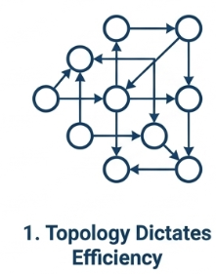
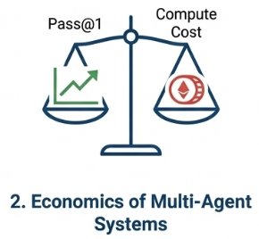
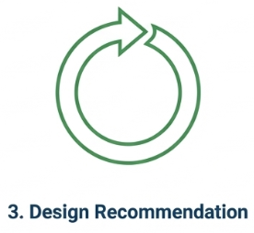
Conclusion
We showed that multi-agent performance gains rely heavily on Interaction Graph structure. Topologies dictate token economics as much as the models themselves
Optimizing topologies for Game-Theoretic Utility is necessary to prevent massive token waste
Future work should prioritize strict execution-feedback cycles over complex, ungrounded parallel LLM debates or hierarchies
Notes:
heres the conclusion. First, topology strongly shapes multi-agent efficiency. Performance gains do not come only from the underlying model. They also depend heavily on how agents are connected and how information flows through the graph. In practice, graph structure affects token cost almost as much as it affects accuracy.
Second, this means we should think about multi-agent systems economically, not just architecturally. A topology is only useful if the additional coordination it introduces actually improves task success enough to justify its compute cost. Otherwise, it simply creates token overhead without meaningful benefit.
Third, the most effective designs are the ones built around tight execution-feedback loops. Our results show that cyclic verification and repair structures are much more efficient than complex parallel debates or deep hierarchies. So adding more communication is not automatically better. What matters is whether that communication directly supports correction.
So overall, the main message of this work is that interaction topology is not a secondary design choice. It is a central determinant of accuracy, efficiency, and incentive stability in multi-agent code generation.

Slide 13
Discussion & Limitation
Future Works
Limitations
Broader Evaluation on complex benchmarks and SE tasks.
Expand the utility model to include latency, tool overhead, and monetary cost.
Develop temporal or trajectory-level attribution methods
Limit to MBPP due to computational limitations.
Equilibrium analysis is empirical and approximate through prompt.
Photo credit: @bruce.digital
Notes:
of course there are some limitations for the study. This slide highlights the main limitations and future directions of our work.
First, our experiments are limited to MBPP because of compute constraints, so the results should be interpreted as controlled evidence rather than a universal conclusion.
Second, the equilibrium analysis is empirical and prompt-based, so it is an approximation of incentive stability, not a formal game-theoretic proof.
For future work, we would like to evaluate on harder software engineering benchmarks, expand the utility model beyond token cost, and develop fine-grained attribution methods that explain interaction dynamics over time.

Slide 14
Q&A
Thank You

